Slide 1
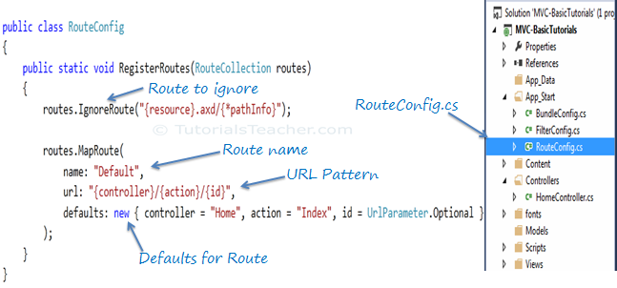
MVC Routing
Configure Route
Every MVC application must configure (register) at least one route, which is configured by MVC framework by default.
You can register a route in RouteConfig class, which is in RouteConfig.cs under App_Start folder.

Slide 2
MVC Routing
In the ASP.NET Web Forms application, every URL must match with a specific .aspx file. For example, a URL http://domain/studentsinfo.aspx must match with the file studentsinfo.aspx that contains code and markup for rendering a response to the browser.
ASP.NET MVC introduced Routing to eliminate needs of mapping each URL with a physical file.
Routing enable us to define URL pattern that maps to the request handler. This request handler can be a file or class.
In ASP.NET Webform application, request handler is .aspx file and in MVC, it is Controller class and Action method.
http://domain/students can be mapped to http://domain/students/info.aspx in ASP.NET Webforms and the same URL can be mapped to Student Controller and Index action method in MVC.

Slide 3
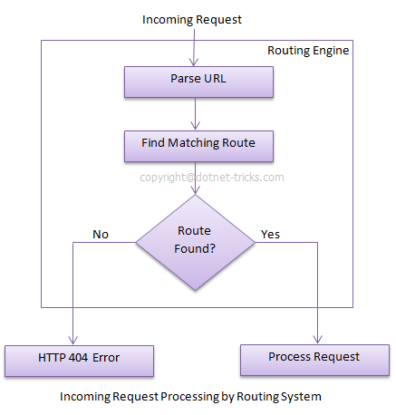
MVC Routing
Route
Route defines the URL pattern and handler information. All the configured routes of an application stored in RouteTable and will be used by Routing engine to determine appropriate handler class or file for an incoming request.

Slide 4
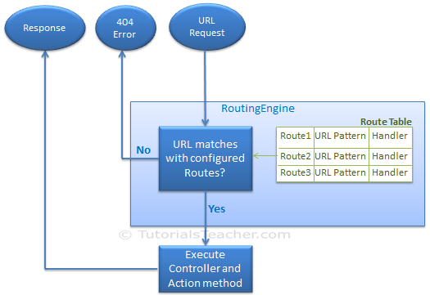
MVC Routing

Slide 5
MVC Routing
As you can see in the above figure, the route is configured using the MapRoute() extension method of RouteCollection, where name is "Default", url pattern is "{controller}/{action}/{id}" and defaults parameter for controller, action method and id parameter. Defaults specifies which controller, action method or value of id parameter should be used if they do not exist in the incoming request URL.
The same way, you can configure other routes using MapRoute method of RouteCollection. This RouteCollection is actually a property of RouteTable class.

Slide 6
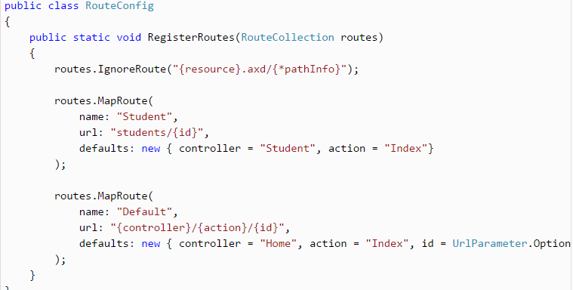
MVC Routing
Multiple Routes
You can also configure a custom route using MapRoute extension method. You need to provide at least two parameters in MapRoute, route name and url pattern. The Defaults parameter is optional.
You can register multiple custom routes with different names.

Slide 7
MVC Routing
Multiple Routes
You can also configure a custom route using MapRoute extension method. You need to provide at least two parameters in MapRoute, route name and url pattern. The Defaults parameter is optional.
You can register multiple custom routes with different names.

Slide 8
MVC Routing
Request URL | Parameters
http://example.com/ | controller=Home, action=Index, id=none, Since default value of controller and action are Home and Index respectively.
http://example.com/Admin | controller=Admin, action=Index, id=none, Since default value of action is Index
http://example.com/Admin/Product | controller=Admin, action=Product, id=none
http://example.com/Admin/Product/1 | controller=Admin, action=Product, id=1
http://example.com/Admin/Product/SubAdmin/1 | No Match Found
http://example.com/Admin/Product/SubAdmin/Add/1 | No Match Found

Slide 9
MVC Routing
Route Constraints
You can also apply restrictions on the value of parameter by configuring route constraints. For example, the following route applies a restriction on id parameter that the value of an id must be numeric.
routes.MapRoute(
name: "Student",
url: "student/{id}/{name}/{standardId}",
defaults: new { controller = "Student", action = "Index", id = UrlParameter.Optional, name = UrlParameter.Optional, standardId = UrlParameter.Optional },
constraints: new { id = @"\d+" } );
Note: if you give non-numeric value for id parameter then that request will be handled by another route or, if there are no matching routes then "The resource could not be found" error will be thrown.

Slide 10
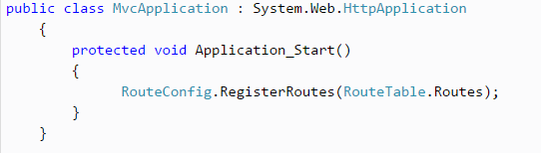
MVC Routing
Register Routes
configuring all the routes in RouteConfig class, you need to register it in the Application_Start() event in the Global.asax. So that it includes all your routes into RouteTable.

Slide 11
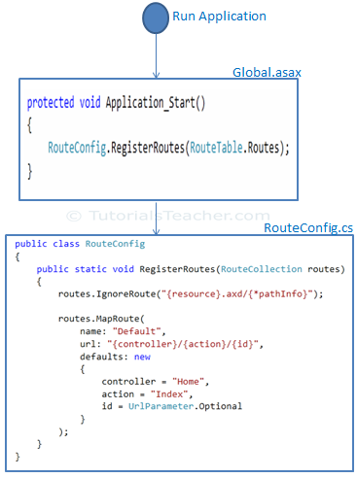
MVC Routing

Slide 12
MVC Routing
Points to Remember :
Routing plays important role in MVC framework. Routing maps URL to physical file or class (controller class in MVC).
Route contains URL pattern and handler information. URL pattern starts after domain name.
Routes can be configured in RouteConfig class. Multiple custom routes can also be configured.
Route constraints applies restrictions on the value of parameters.
Route must be registered in Application_Start event in Global.ascx.cs file.

